Slide 2

Young Professionals Program 4
Intern Huy Phan | 2025

Slide 3

Internship Milestone Review
Intern Huy Phan | 2025

Slide 4
Agenda
Introduction
Objectives
Work Accomplished
Achievements
Challenges & Solutions
Conclusion & Q&A

Slide 5

Introduction
Intern Huy Phan | 2025

Slide 6
Objectives
Intern Huy Phan | 2025

Slide 7

Objectives
Technical: apply real-world knowledge (DB, MVC, DI, Testing...).
Soft Skills: communication, critical thinking, time management, AI adoption.
Outside Activities: networking, cultural exploration.

Slide 8
Work Accomplished
Intern Huy Phan | 2025

Slide 9
Work Accomplished - Technical
UI Analysis → Database Design.
Build MVC & DI from scratch.
Performance optimization for production.
Unit Testing (Google Drive, MVC, DI).
Studied 4 Design Patterns. (Singelton, Abtract Factory, Method Factory, Builder)

Slide 10
Work Accomplished - Soft Skills
Critical Thinking & Decision Making.
Effective Communication & Smart Questioning.
Problem Solving & Time Management.
English Club
How to Work with AI.

Slide 11
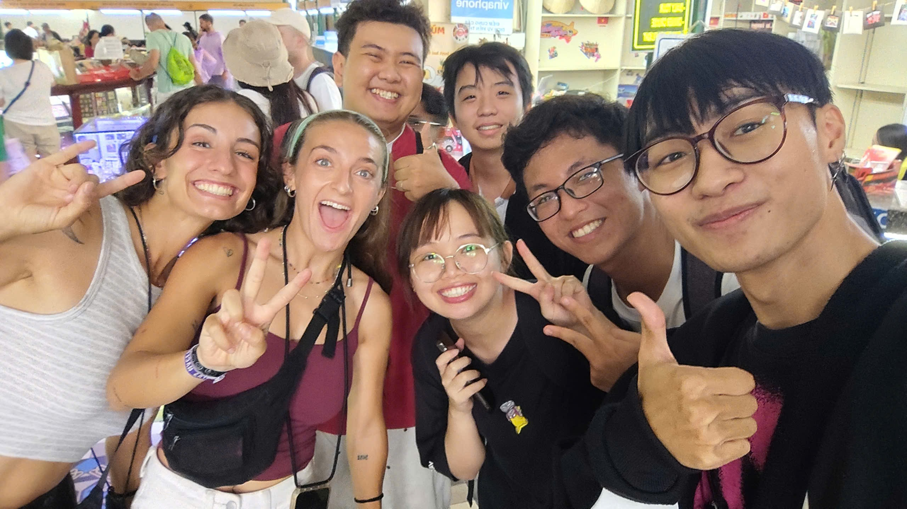
Work Accomplished - Outside Activities
Sightseeing at Post Office & History Museum.
Conversations, interviews, and photos with foreigners.

Slide 12
Achievements
Intern Huy Phan | 2025

Slide 13
Achievements - Technical
UI Analysis → Database Design.
Build MVC & DI from scratch.
Performance optimization for production.
Unit Testing (Google Drive, MVC, DI).
Studied 4 Design Patterns. (Singelton, Abtract Factory, Method Factory, Builder)

Slide 14
Achievements - Soft Skills
Critical Thinking & Decision Making.
Effective Communication & Smart Questioning.
Problem Solving & Time Management.
English Club
How to Work with AI.

Slide 15
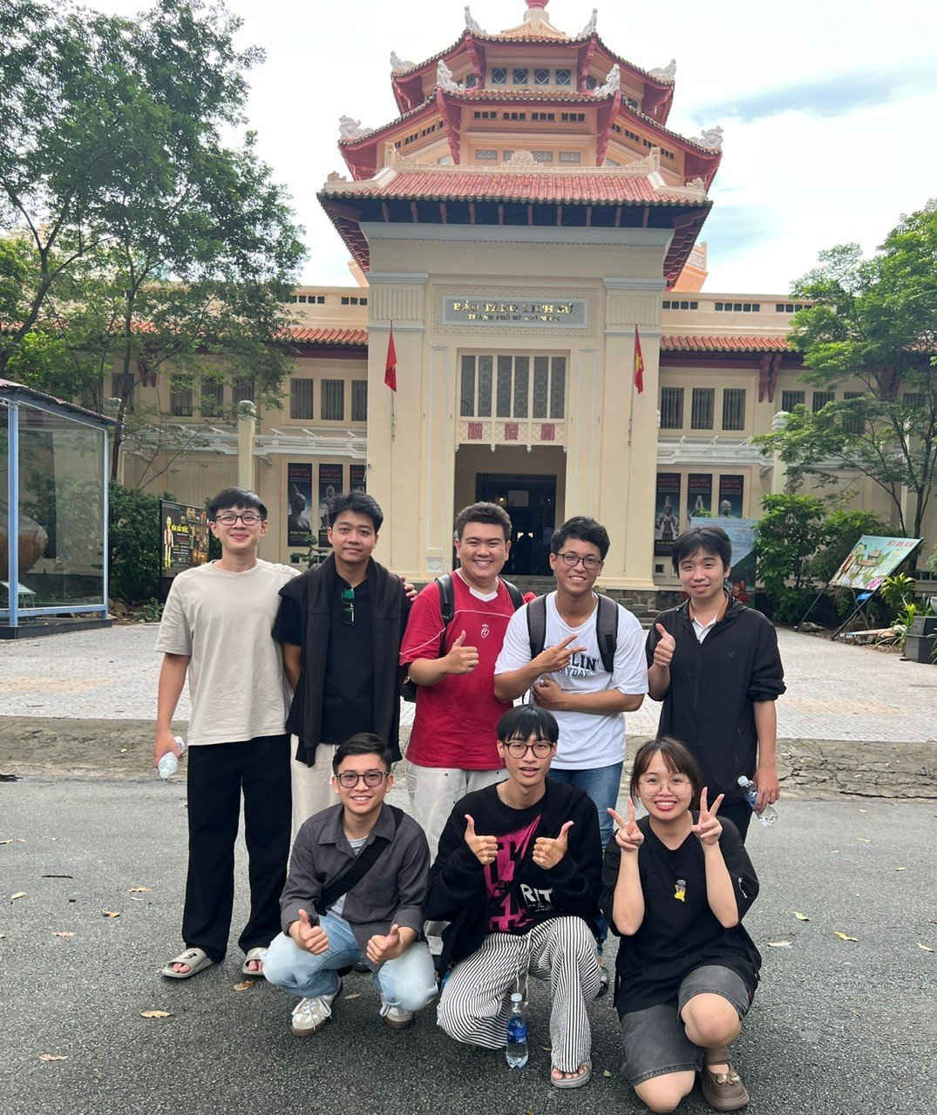
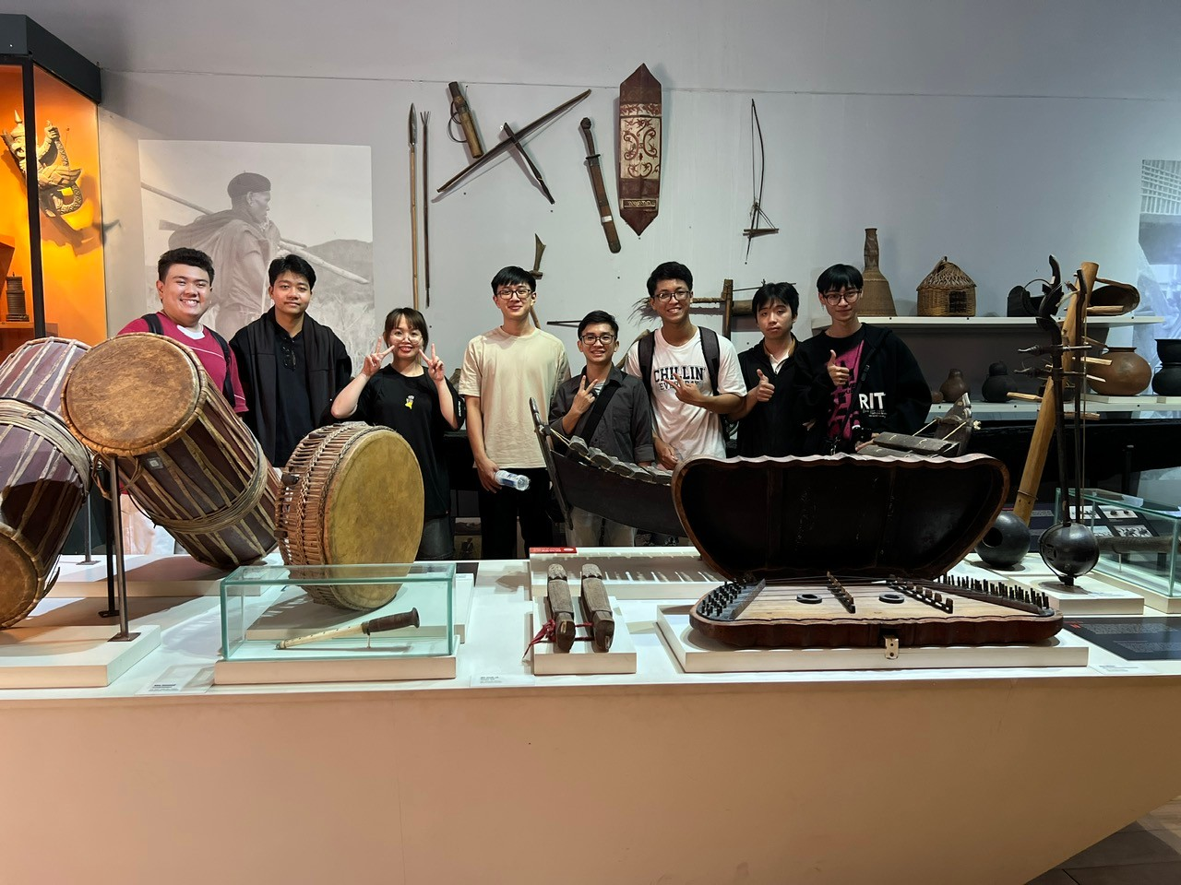
Achievements - Outside Activities
Sightseeing at Post Office & History Museum.
Conversations, interviews, and photos with foreigners.

Slide 16
Challenges & Solutions
Intern Huy Phan | 2025

Slide 17
Challenges & Solutions
Challenge | Solution
Database design based on UI | Mentor guidance + self-learning.
Writing Unit Tests for the first time | Reviews + practice.

Slide 18
Conclusion & Q&A
Intern Huy Phan | 2025

